Slide 1
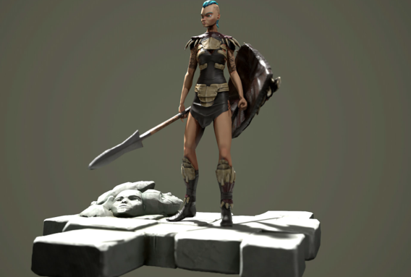
Workshop 3

Slide 2
Asset Development
Continue to add assets to your playground being sure to animate them as you go if you want to put them in your final animation.

Slide 3
Lighting
Once you have completed the environment and your animations, place appropriate lighting in the scene.
You may wish to have the camera focused on one activity or a general overview of the whole playground remember though even just 30secs of film will take a while to render out

Slide 4
Rendering
If you need a reminder on the settings required to render out your animation look at the Animation – Lighting and Rendering power point.
Be sure to check the time the render will take so you don't start the render without enough time for it to finish

